Slide 1


CMR TECHNICAL CAMPUS
UGC (Autonomous)
Kandlakoya, Medchal Road, Hyd-501 401
Department of Electronics & Communication Engineering
Real Time Project Review
EV CHARGING PATH
BATCH NO : 11
Project Guide : ROLL NUMBERS :
G.SRIKANTH
professor & HOD of ECE DEPT
Project Coordinator :
Dr.ch. Sudhamani
Associate professor
237R5A0402 – SAI CHARAN
237R5A0401 – VIKAS
227R1A0433 – NITHIL
227R1A0439 - PAVAN

Slide 2
CONTENTS
ABSTRACT
INTRODUCTION
LITERATURE SURVEY
EXISTING MODEL Vs PROPOSED MODEL
BLOCK DIAGRAM
BLOCK DIAGRAM DESCRIPTION
CONCLUSION
FUTURE SCOPE
REFERENCES

Slide 3
ABSTRACT
Introduction to Electric Vehicles (EVs) is an alternative to traditional vehicles due to resource depletion.
Wireless Power Transfer (WPT) is a solution for charging EV batteries without cables.
Design and implementation of a prototype wireless charger with a 60 kHz operation frequency.
Challenges:-Plug-in Electric Vehicles (PEV) are burdened by the need for cable and plug charger,bulk and cost of this charger and the large energy storage system (ESS) packs needed
Advantages of Wireless Charging: convenience, electrical isolation, grid-side regulation, and reduced on-board ESS size with dynamic on-road charging.
Objective: Designing and developing an antenna system suitable for vehicles using resonant magnetic coupled wireless power transfer technology.
Application of WPT in EVs: clean, convenient, and safe operation.

Slide 4
INTRODUCTION
Transitioning to sustainable transportation with a focus on electric vehicles (EVs).
Critical challenge: Efficient EV charging infrastructure.
Project focus: Dynamic EV charging while in motion on the road.
Goal: Revolutionize EV charging experience for convenience and feasibility.
Bridging theoretical advancements with practical implementation for a sustainable future.

Slide 5
LITERATURE SURVEY
Serial Number | Author(s) Name | Title of the Paper | International Journal/Conference | Issue | Advantages/disadvantages
1 | Amritansh Sagar | A Comprehensive Review of the Recent Development of Wireless Power Transfer Technologies for Electric Vehicle Charging Systems | IEEE | 01 Aug 2023 | ->Comprehensive review of wireless power transfer technologies./ ->Limited in-depth analysis or comparison between methods.
2 | A. Sai Praneeth | Designing inductive coils for wireless power transfer for electric vehicles | AIP Conference proceedings | 15 Dec 2023 | ->Detailed guidelines for designing inductive coils/ ->Requires a solid background in electromagnetic theory.
3 | Thomas Gabet | Thermo-viscoelastic analysis of an inductive charging system included in an eRoads. Incit-ev project | Transportation Engineering – science direct | March 2023 | ->Discusses the potential of wireless power transfer for autonomous operation./ ->May prioritize theoretical concepts over practical implementation challenges.

Slide 6
Serial Number | Author(s) Name | Title of the Paper | International Journal/Conference | Issue | Advantages/disadvantages
4 | Emilia M. Szumska | Electric Vehicle Charging Infrastructure along Highways in the EU | MDPI | 12 Jan 2023 | ->Discusses the potential of wireless power transfer for integrating renewable energy./ ->May lack specific details on practical implementation challenges.
5 | Pierre Hornych | Design of a pavement solution for electric vehicle charging by induction | HAL open science | 2023 | ->Dynamic inductive charging offers seamless and vandalism-resistant EV charging/ ->Integrating inductive charging into pavements requires careful material selection and road design for optimal performance.

Slide 7
Existing model Vs. Proposed model
Existing Model:
Typically focuses on stationary EV charging solutions.
Infrastructure includes charging stations and designated parking spots.
Relies on battery swapping or plug-in charging methods.
Challenges include limited charging points and range anxiety for drivers.
Proposed model:
Focuses on dynamic EV charging while the vehicle is in motion on the road.
Infrastructure involves embedding charging technology in roadways or utilizing wireless charging systems.
Aims to eliminate the need for frequent stops at charging stations, enhancing the convenience of EV usage.

Slide 8
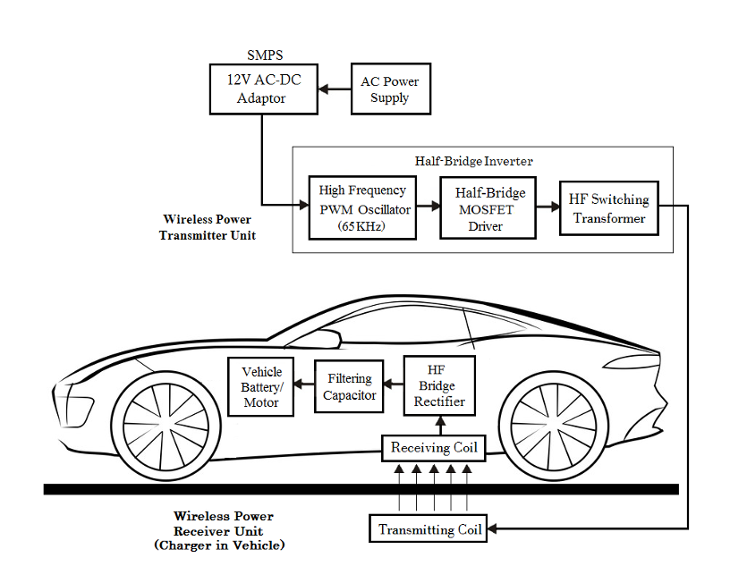
BLOCK DIAGRAM

Slide 9
BLOCK DIAGRAM DESCRIPTION:
AC Power Supply: Takes power from an AC220v source.
AC-DC Adapter (SMPS): Converts AC to DC, providing 12v DC output.
High Frequency PWM Oscillator: Generates PWM switching pulses at 65 KHz for MOSFET control.
Driver MOSFETs: Switches the high frequency transformer to produce an AC square wave.
High Frequency Transformer: Converts DC to high-frequency AC, with low conversion losses due to ferrite core.

Slide 10
Half Bridge Inverter: Converts DC to high-frequency AC for transmission.
Transmitting Coil: Converts high frequency electrical current into electromagnetic waves.
Receiving Coil: Receives and converts electromagnetic waves back to electrical output.
HF Bridge Rectifier: Converts HF AC voltage from the receiving coil to DC.
Filtering Capacitor: Smooths and stabilizes DC voltage output for driving the vehicle motor or charging the battery.

Slide 11
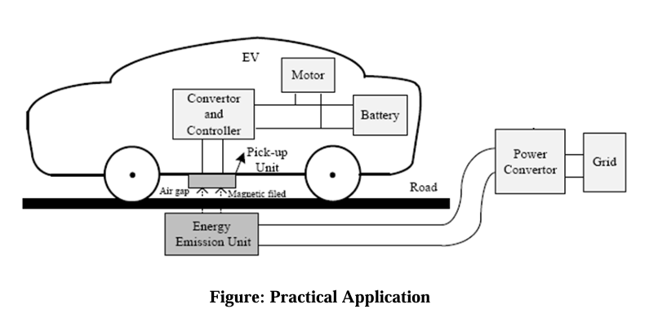
PRACTICAL APPLICATION
The electrical power flows from the power transmitter coil inside the platform to the receiving coil inside the bottom of the electric vehicle. Electrical charging is done once the resonant frequency of both the coils matches and the vehicle charged automatically. When the vehicle is moved the charger goes to the power saving mode and cut off the charger coil.

Slide 12
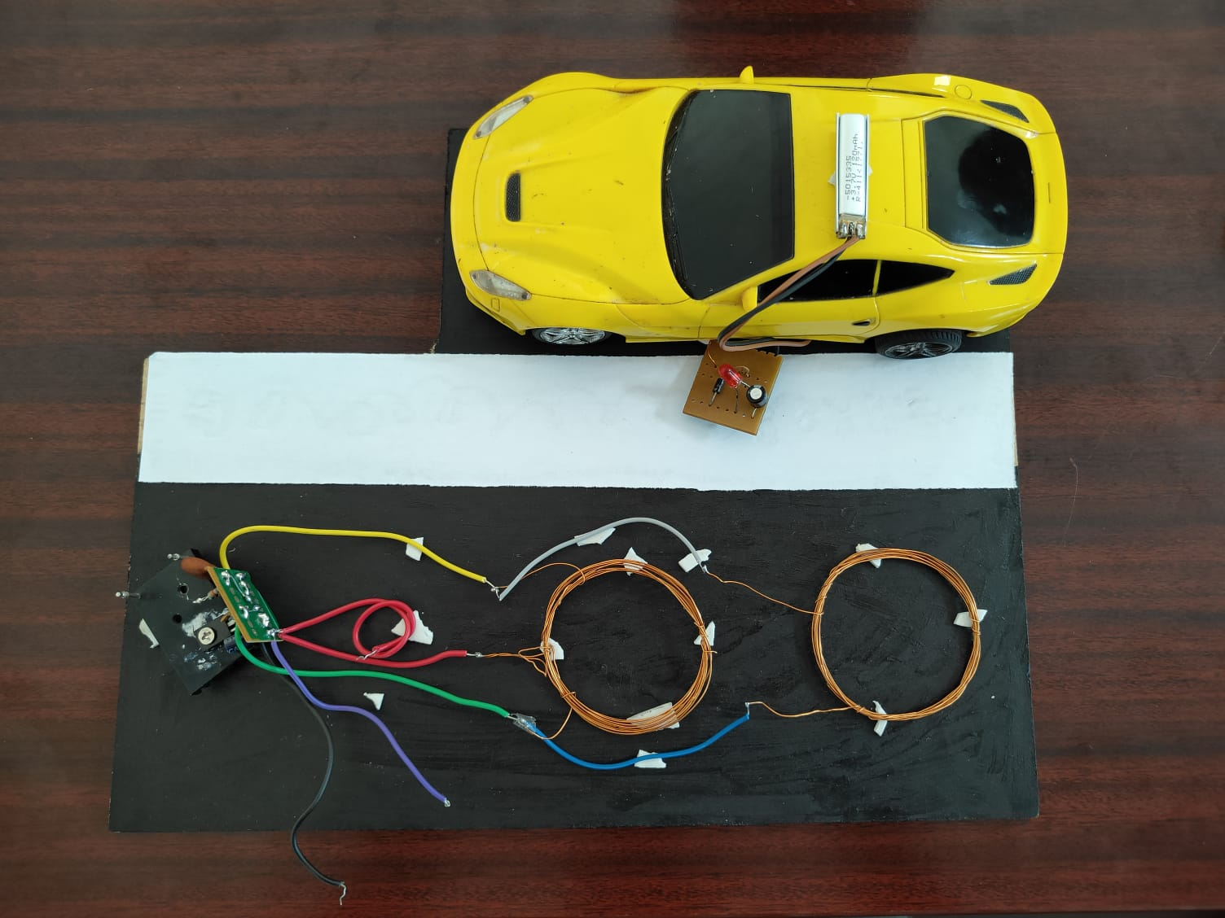
Results
Case 1:When the vehicle is on regular/normal road it is not charging.

Slide 13
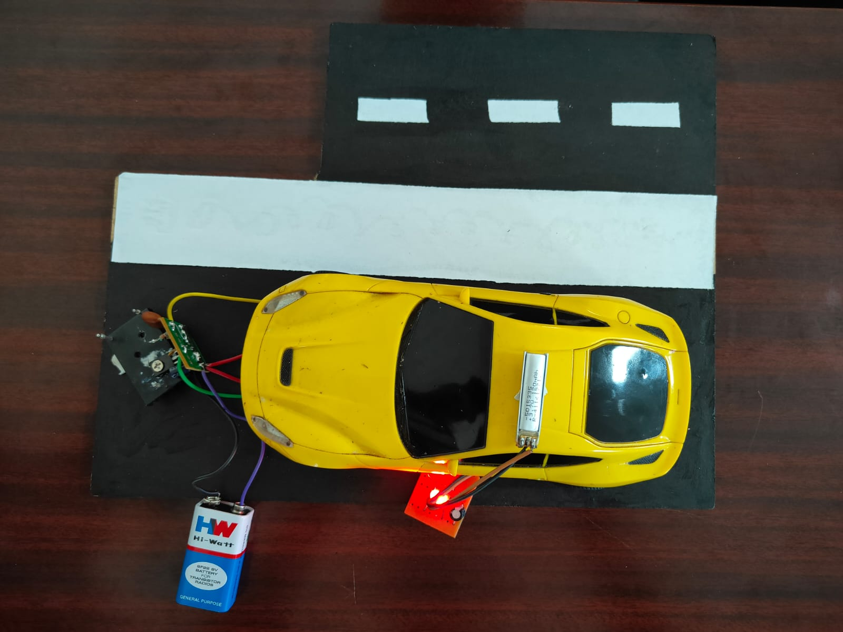
Case 2: When the vehicle is on dynamic charging lane the vehicle gets charged.

Slide 14
CONCLUSION
The results of this project demonstrate the feasibility and potential of using resonant magnetic coupling for wireless power transfer in electric vehicles. The prototype system achieved high power transfer efficiency under optimal conditions and showed good tolerance to misalignments and variations in distance. While several practical challenges remain, the findings indicate that WPT technology can significantly enhance the convenience and practicality of EV charging, supporting the broader adoption of electric vehicles..

Slide 15
FUTURE SCOPE
Future work should focus on improving alignment mechanisms, enhancing thermal management, and exploring advanced materials to further optimize the system's performance and cost-effectiveness..

Slide 16
REFERENCES
Zhang, Yanyu, et al. "Ev-road-grid: Enabling optimal electric vehicle charging path considering wireless charging and dynamic energy consumption." 2021 IEEE 94th Vehicular Technology Conference (VTC2021-Fall). IEEE, 2021.
Qiang, Xing, et al. "Route planning and charging navigation strategy for electric vehicles based on real-time traffic information and grid information." IOP Conference Series: Materials Science and Engineering. Vol. 752. No. 1. IOP Publishing, 2020.
Lee, Ki-Beom, Mohamed A. Ahmed, Dong-Ki Kang, and Young-Chon Kim. "Deep reinforcement learning based optimal route and charging station selection." Energies 13, no. 23 (2020): 6255.

Slide 17
THANK YOU

